Slide 1

Code & Title : Sign Language Subtitle Generator(சைகை - துணை)
Thrust Area : Subtitle Generation
Campus Name : VELLORE / CHENNAI
Reg.Nos & Names: 20BLC1077 - DHANUSHVARDAN A V J,
20BLC1031 - PRANAAV S
20BLC1132 - KRITHIKA S
20BLC1050 - GOWTHAM BAALAJI K
Mentor Name : Dr. Shoba S

Slide 2
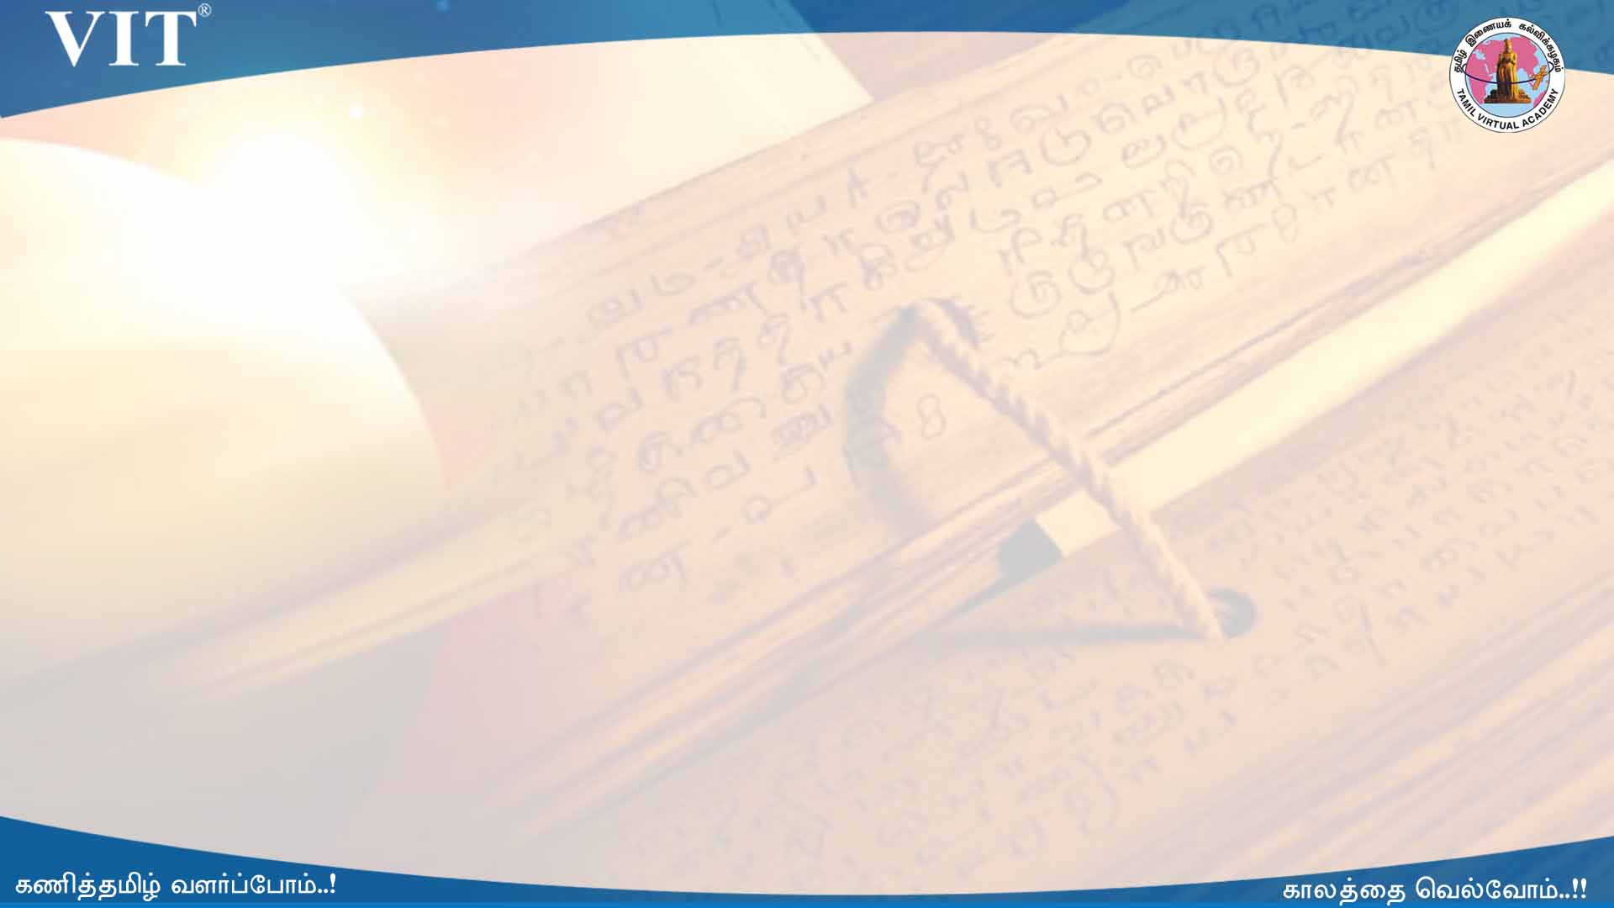

Idea/Approach Details
Developing successful sign language recognition, generation, and translation systems in the Tamil language requires expertise in a wide range of fields, including computer vision, computer graphics, natural language processing, human-computer interaction, linguistics, and Deaf culture. Despite the need for deep interdisciplinary knowledge, existing research occurs in separate disciplinary silos, and tackles separate portions of the sign language processing pipeline. This leads to three key questions: 1) What does an interdisciplinary view of the current landscape reveal? 2) What are the biggest challenges facing the field? and 3) What are the calls to action for people working in the field? To help answer these questions, we brought together a diverse group of experts for a two-day workshop. This paper presents the results of that interdisciplinary workshop, providing key background that is often overlooked by computer scientists, a review of the state-of-the-art, a set of pressing challenges, and a call to action for the research community. We generate subtitles for the sign languages with proper training of our model and proper testing over various input data.

Slide 3
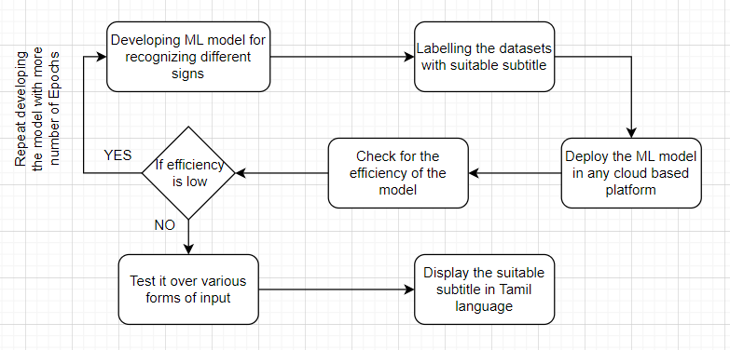

Slide 4
Describe your Technology stack here:
Machine Learning Model - Our ML Model suitably analyses the hand gestures of different signs and thus generate subtitles accordingly to which the model is trained with.
Cloud Platform - The trained and tested model is deployed in Cloud Platform so that the model could work efficiently.

Slide 5
Describe your Use Cases here / Input and Output
Input - In the form of video via webcam or generated video data.
Output - Continuous display of generated subtitles with accuracy values nearby.
Functions - Training of the dataset available efficiently and testing it over real-time data, for recognizing the sign language, and then deploying our model in cloud platform.

Slide 6
Conclusion and Feature works
Thus, our model efficiently predicts and recognizes the signs shown through webcam, and thereby generating subtitles according to the training of the datasets happened.
Future Scope - This prototype can be used in News Channel Telecasting where a trained employee enacts the news read by the newsreader, in which suitable subtitles in tamil can be displayed along with their video so that, people with disabilities could follow day-to-day news, without missing or mistreating any incidents broadcasted via news channels.

Slide 7
Team Member Details
Team Leader Name and RegNo: Dhanushvardan A V J, 20BLC1077, dhanushvardan.avj2020@vitstudent.ac.in, 8608610034
Team Member 1 Name and RegNo : Pranaav S, 20BLC1031
Team Member 2 Name and RegNo : Krithika S, 20BLC1132
Team Member 2 Name and RegNo : Gowtham Baalaji K, 20BLC1050

Slide 8



